Slide 1



Personal Finance
View in Power BI
Last data refresh:
07/12/2024 11:24:32 UTC
Downloaded at:
07/12/2024 11:31:10 UTC

Slide 2
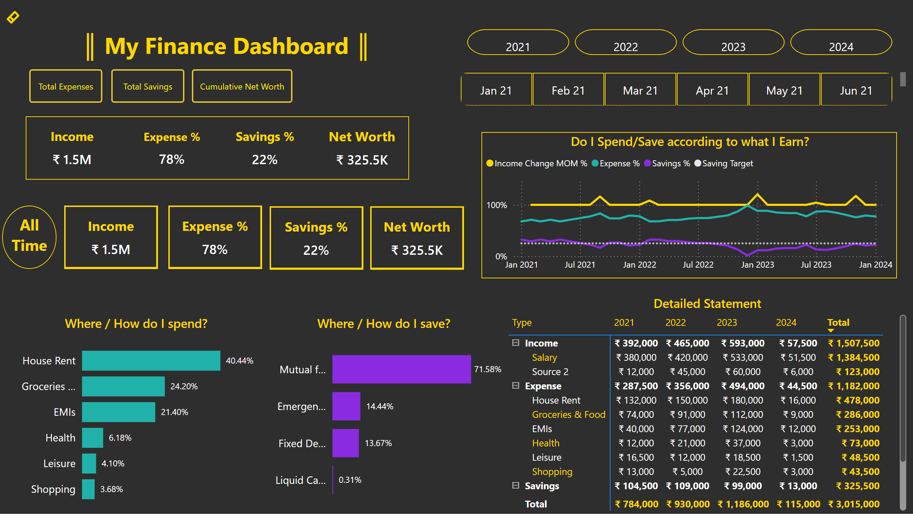
Fin Dashboard
Notes:
cardVisual
No alt text provided
cardVisual
No alt text provided
cardVisual
No alt text provided
cardVisual
No alt text provided
advancedSlicerVisual
No alt text provided
advancedSlicerVisual
No alt text provided
textbox
No alt text provided
cardVisual
No alt text provided
cardVisual
No alt text provided
cardVisual
No alt text provided
cardVisual
No alt text provided
Where / How do I spend?
No alt text provided
Where / How do I save?
No alt text provided
Do I Spend/Save according to what I Earn?
No alt text provided
textbox
No alt text provided
Detailed Statement
No alt text provided
actionButton
No alt text provided
shape
No alt text provided
shape
No alt text provided
actionButton
No alt text provided
actionButton
No alt text provided
actionButton
No alt text provided

Slide 3
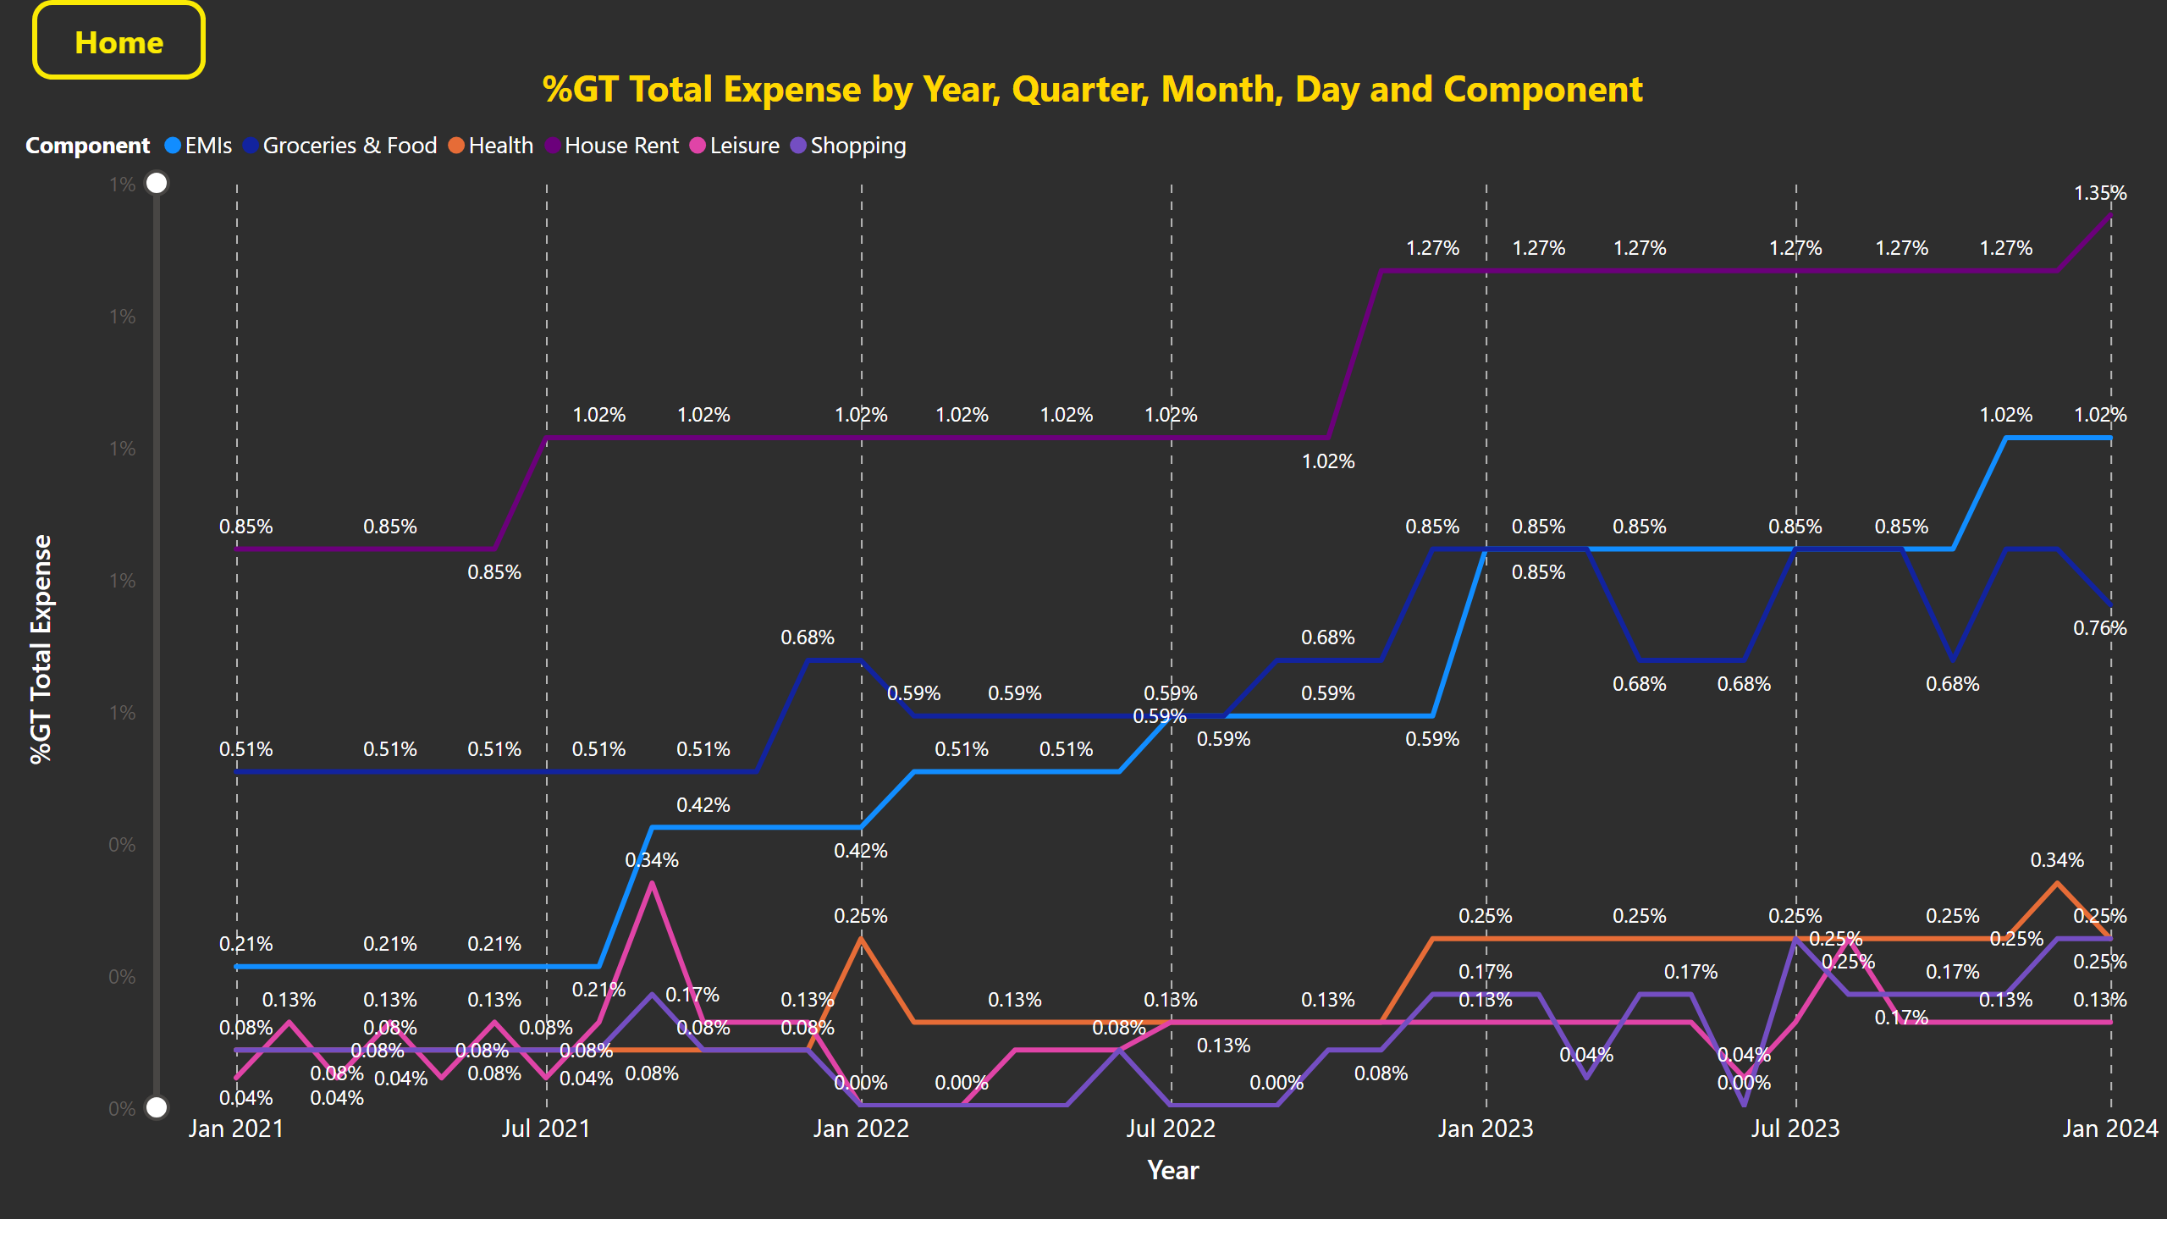
Total Expns
Notes:
lineChart
No alt text provided
actionButton
No alt text provided

Slide 4
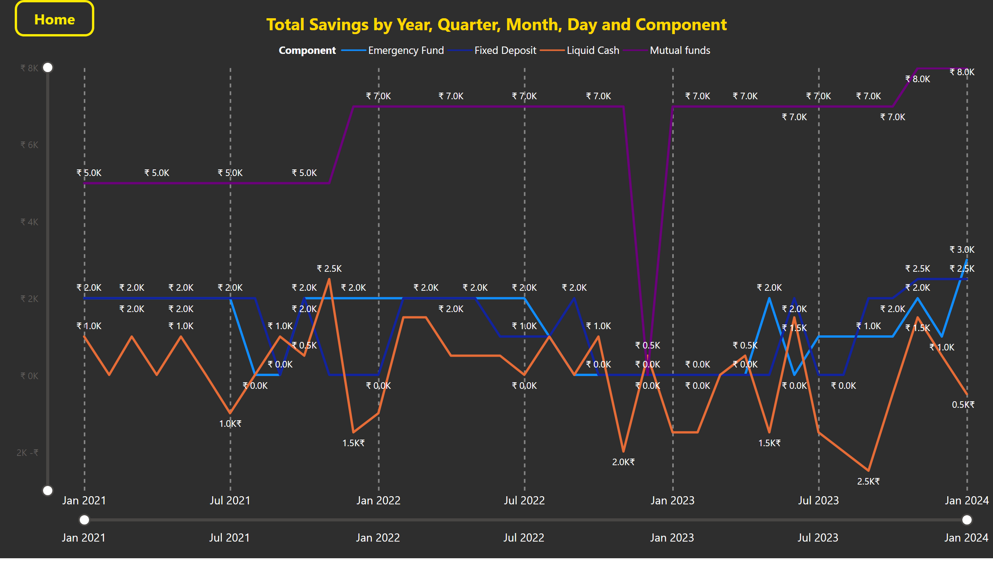
Total Savings
Notes:
lineChart
No alt text provided
actionButton
No alt text provided

Slide 5
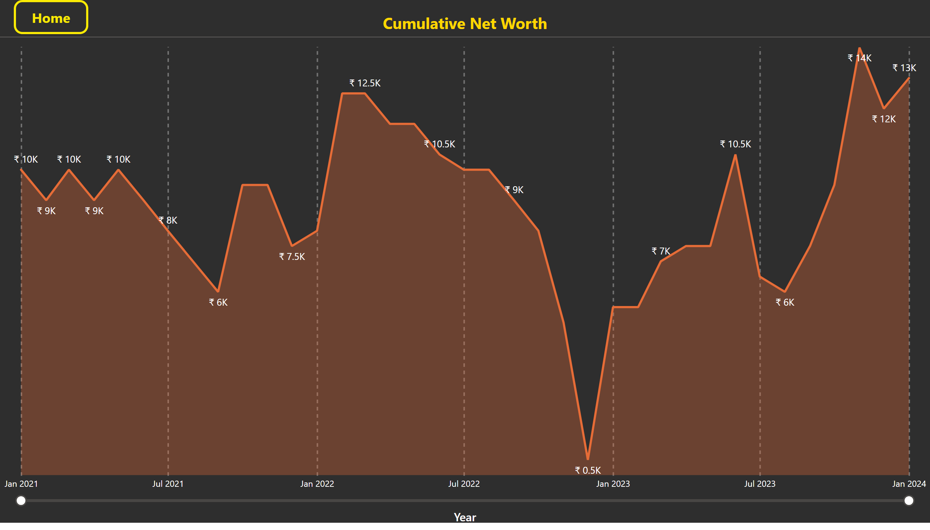
Cumulative Net Worth
Notes:
Cumulative Net Worth
No alt text provided
actionButton
No alt text provided

